Slide 1
Best jokes?
If Apple made a car would it have windows?
What do you call a newspaper article about a Porsche 911 driver?...An obituary
What happens when a frog parks in a no-parking space?...It gets toad away.
A guy walks into a parts store and says, "I need a gas cap for my Kia." The clerk says, "Okay, sounds like a fair trade."
A mechanical engineer, electrical engineer, and computer engineer are in a car that breaks down on the side of the road. "Hang on," says the mechanical engineer, " The problem is probably the engine. Let me take a look at it and I'll have us on the road in no time." "Wait," says the electrical engineer, "The way it just stopped like that, I think it's the electrical system. Let me have a look and I'll get us going again in a minute or two." "Hold on," says the computer engineer, "Why don't we all just get out of the car and get in again and then see if it starts?"

Slide 2
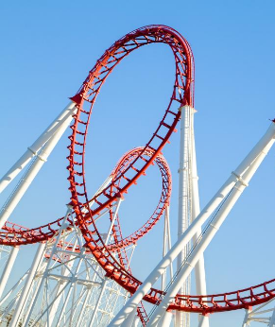
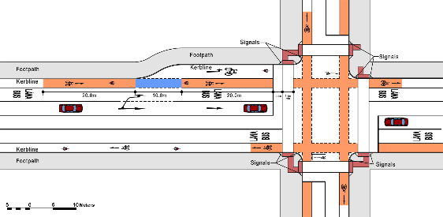
Automotive Vehicle Dynamics
Lecture 07 – Steady-State Cornering 1 Kinematic Steering
Sean Brennan
Department of Mechanical and Nuclear Engineering
Penn State University
sbrennan@psu.edu

Slide 3

Is it possible to have motion without force?
$$\sum{F}=ma$$

Slide 4
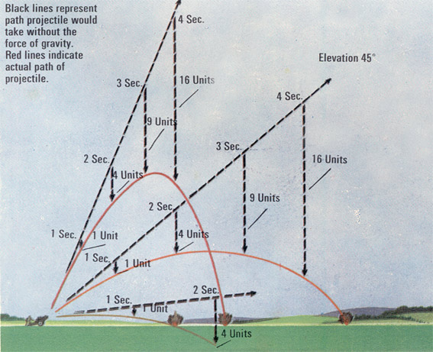
We forget about that “other” law…
“An object in motion must stay in motion, unless acted upon by an outside force.”

Slide 5
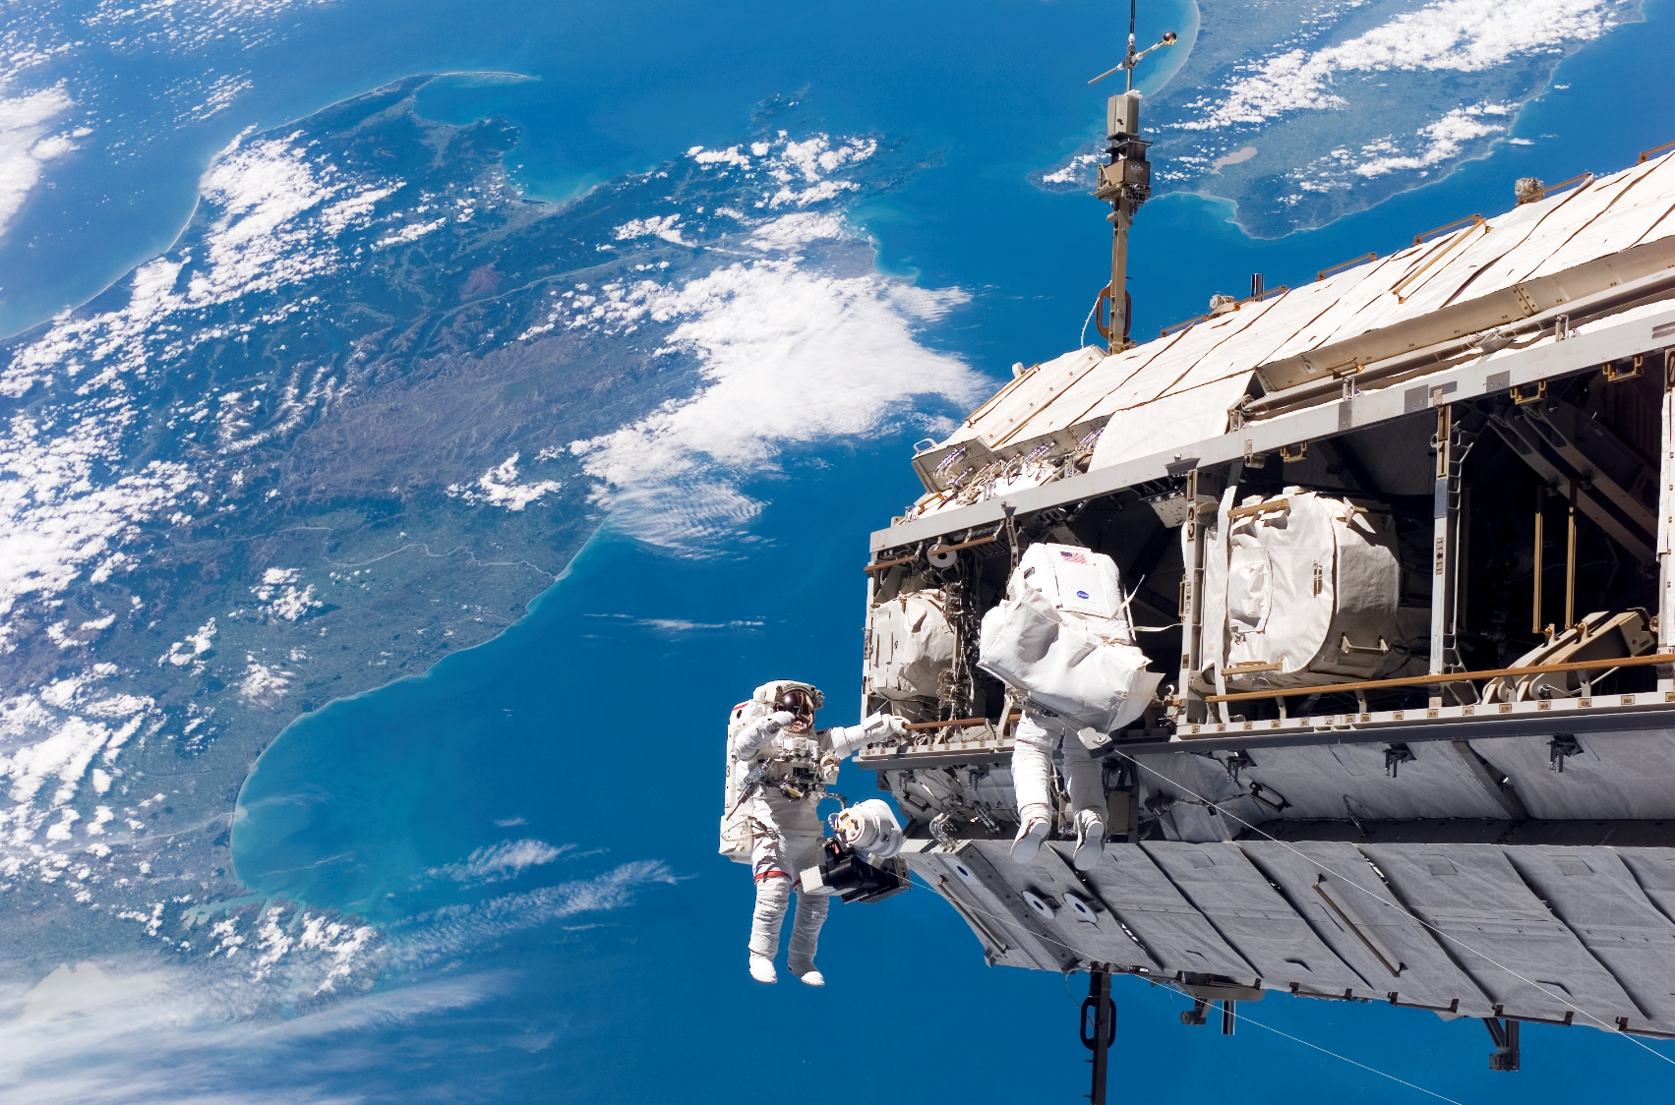
Kinematics is really only valid in outer space
It’s one of the rare places we’ve been where we’re not acted on by (obvious) outside forces.

Slide 6
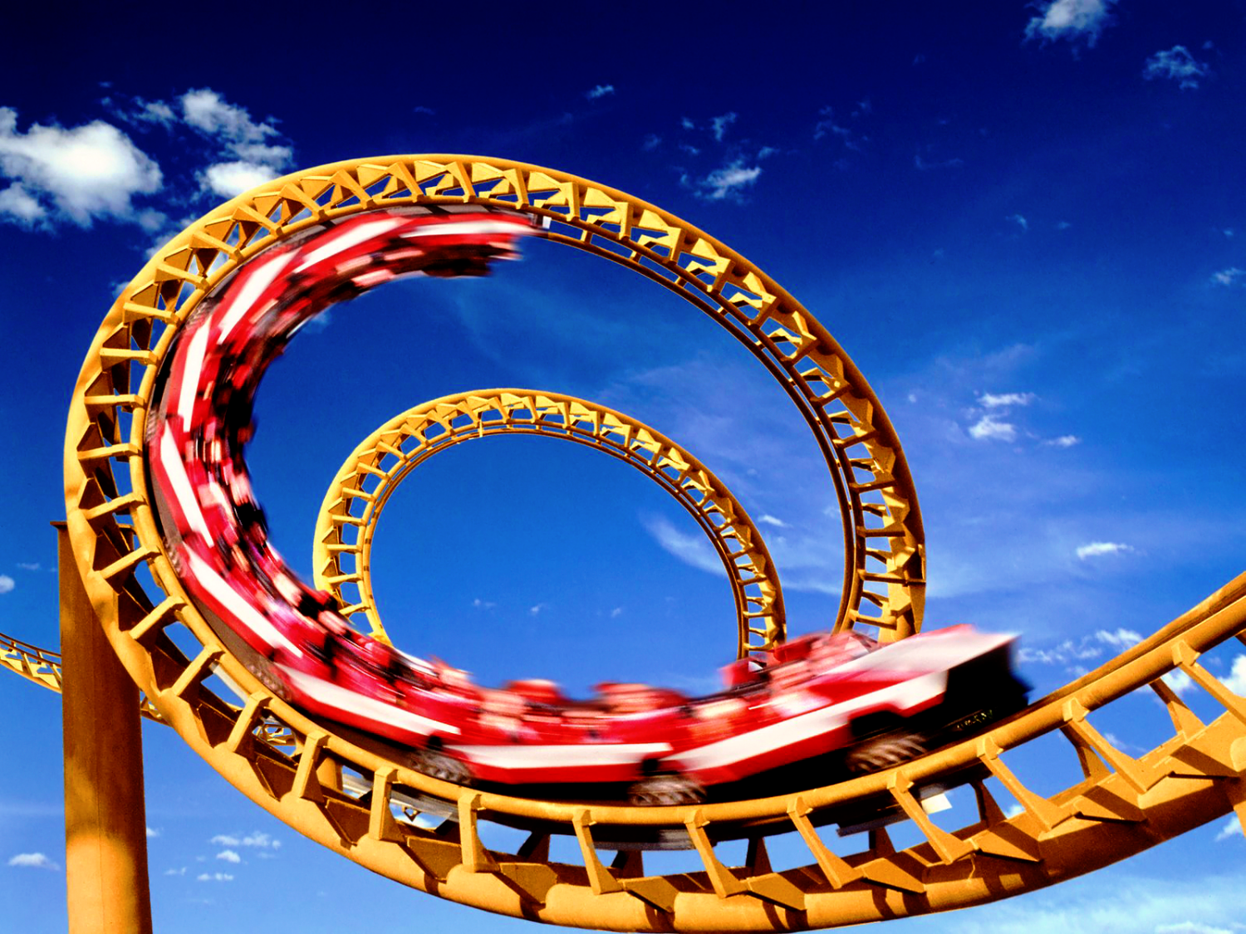
But there are situations where the only motion we care about is along a constrained path. This is also kinematics.

Slide 7
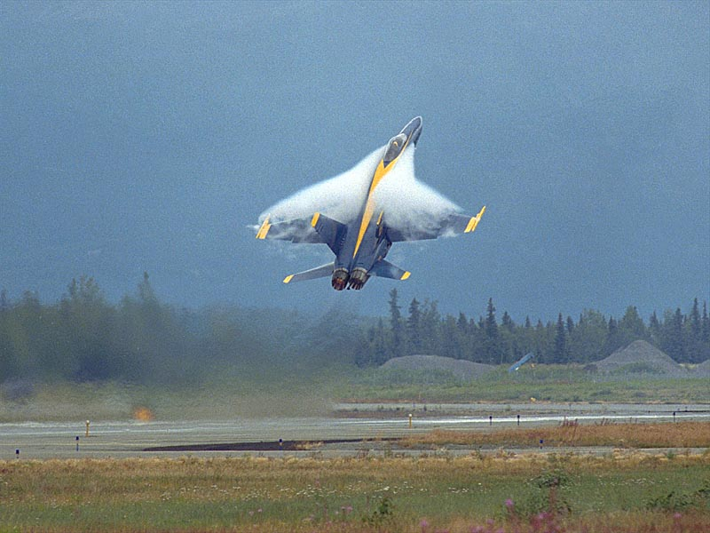
Tires are like wings: they produce force proportional to slip
* But only in a small region around the operating point. We call deviations from this region “skidding” in vehicles, or “stall” in aircraft. Both are deadly.

Slide 8
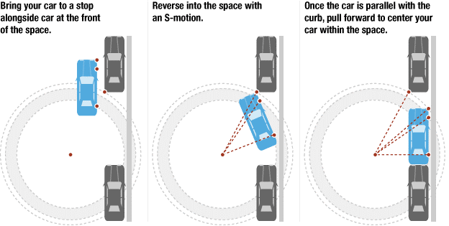
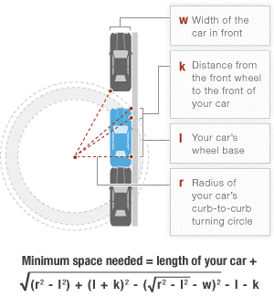
We usually assume that low-speed motion is kinematic
Parallel parking is an example!

Slide 9
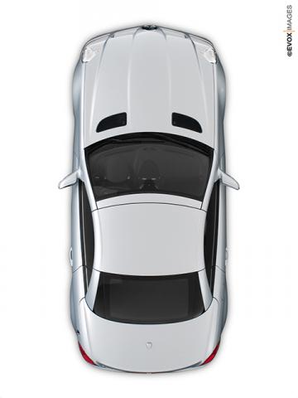
A poorly designed steering system may have the tires turning around different radii, which violates kinematic assumptions
Consider a simplified steering schematic for a given turning radius.
Center of
turning radius
for right wheel
Center of
turning radius
for left wheel

Slide 10
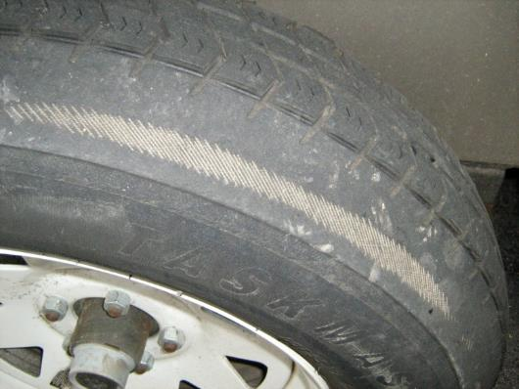
This causes problems…
Small vehicles, which sometimes have inexpensive steering systems, often show high tire wear.
This is usually because the two front tires don’t turn about the same turning radius.
This creates tire ‘scrub’ as the wheels tend to fight each other.

Slide 11
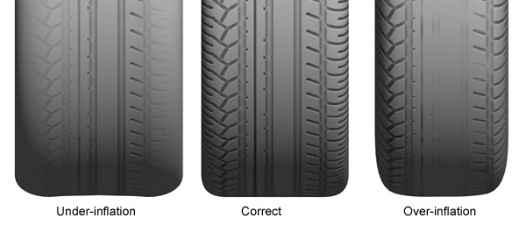
But in kinematic motion, tires are assumed to NOT slip
For kinematic motion, tires MUST be pointed in the direction they are rolling
This means that the tire should be tangent to any radii it is moving around

Slide 12
Final Project
Ben Holbert and Mark Joyce

Slide 13
Steering Angle for Each Car
Notes:
We calculated the maximum steering angel for each car. You can see that tracks and vans have a lower steer angle. The Mazda Miata and Honda Odyssey have the largest steering angles.

Slide 14
Average Steering Angle and Wheelbase by Class
Notes:
Before plotting Wheelbase and steering angle for each class of cars, we would expect classes with higher wheelbases would have a greater steering angle. However, our calculations showed otherwise. The trucks and vans, which had the longest wheelbase, happened to have the lowest steering angle.

Slide 15
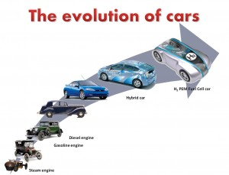
Let’s take a detour through history

Slide 16
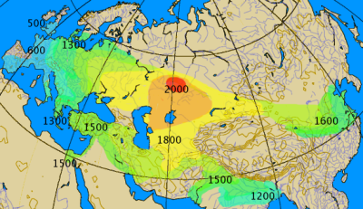
The earliest vehicles were in Mesopotamia, 3000 BC
Here, chariots were typically used in warfare to deliver fresh warriors to crucial parts of the battlefield
Approximate historical map of the spread of the spoke-wheeled chariot, 2000–500 BC (http://en.wikipedia.org/wiki/Chariot )

Slide 17
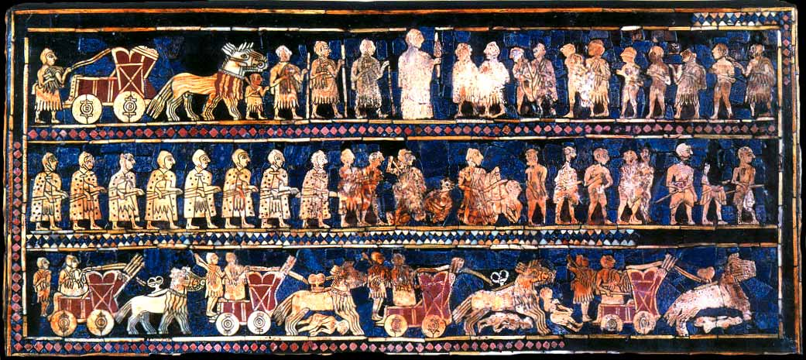
The Standard of Ur, 2500 BC, is the earliest documentation of vehicles in the context of war
Note the solid wheels and oxen. Horses started appearing in 2000 BC. Spoked wheels didn’t appear in Mesopotamia until mid-2000’s BC. (http://en.wikipedia.org/wiki/Chariot)

Slide 18
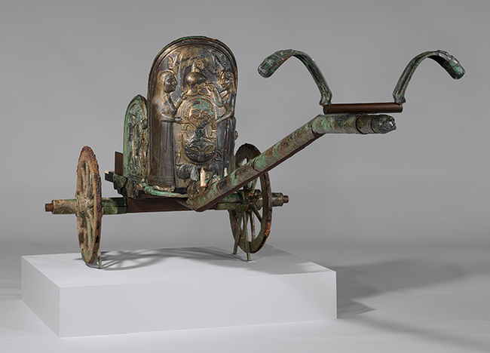
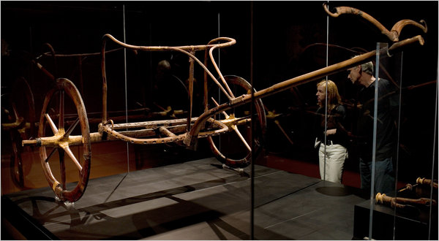
300 ancient chariots are known to exist, but only 6 are complete
The best in existence in in the Metropolitan museum in New York (go see it!). For a while (2010), King Tut’s Chariot was there too!
Want to learn more? Read the “The rise and decline of the Tutankhamun-class chariot” by Bela Sandor, or watch “Building Pharaoh’s Chariot”, http://www.pbs.org/wgbh/nova/ancient/pharaoh-chariot.html
http://www.nytimes.com/2010/08/03/arts/design/03chariot.html?ref=design&_r=0

Slide 19
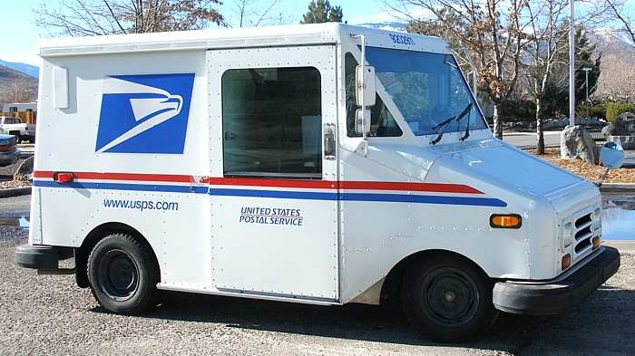
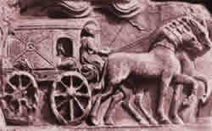
Since Roman times, leaf springs consisting of elastic wooden poles were used on a 2-wheeled Pilentum
Originally used for sacred transport, e.g. statues of gods and cult objects. Later modified for delivery of mail.
Looks surprisingly similar!
http://www.euachei.com.br/educacao/curiosidades/roda/

Slide 20
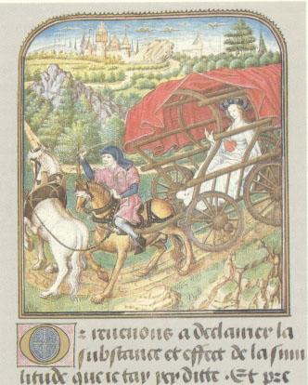
The word “car” comes either from cart or carriage, and originates from Old Northern French around 14th century, or from Latin carrum or Gaulish karros, from British Isles
These were influenced by Roman sprung wagons
(1st century AD)
http://en.wikipedia.org/wiki/Carriage#mediaviewer/File:Kobelwagen,_Jean_Le_Tavernier,_nach_1455.jpg

Slide 21
“Fast” transportation started in Hungary
Under King Mathias Corvinus, Hungarians developed fast road transport between Budapest and Vienna
Fast = faster than a horse or human could easily jog, or faster than about 5 mph
From 1475 to 1550, the Hungarian coach spread through Europe that utilized a leather-strap suspension to create a smooth ride

Slide 22
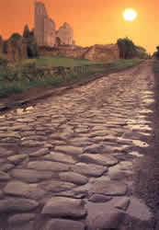
The next key advancement was the improvement in roads
Roman roads were good, but the Romans required the land-owners to maintain them. Which didn’t happen (and still doesn’t).
It wasn’t until 1700’s that governments became rich enough to re-discover Roman building methods and once again produce usable roads.
As a result, speeds on some major roads rose from 5 mph in 1800 to about 10 mph in 1820.
http://en.wikipedia.org/wiki/History_of_road_transport

Slide 23
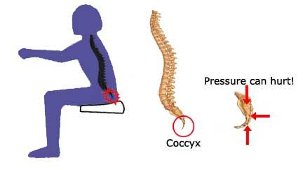
One result of traveling faster? Sore bums!
http://www.motorera.com/history/hist08.htm

Slide 24
How to fix sore bums and backs? Suspension!
The first steel springs were used in a leaf-spring design on French carriages in the 18th century
The first leaf spring suspensions were “invented” by Obadiah Elliot of London in 1804, though leaf springs have been around since early Egyptians
The coil spring is not recent, either. The first patent for such a spring (British patent No. 792) was issued to R. Tredwell in 1763. The main advantage of coil springs was that they did not have to be spread apart and lubricated periodically to keep them from squeaking, as leaf springs did.
Roads improved dramatically around this time as well
http://www.motorera.com/history/hist08.htm

Slide 25
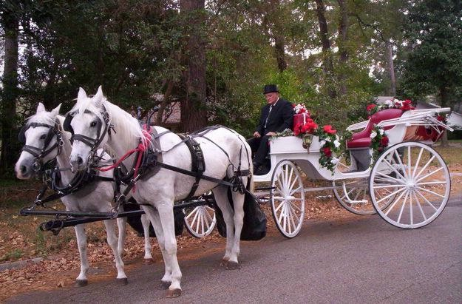
Until the late 1700’s, steering was usually accomplished with a 5th wheel system
http://www.weddingbycolor.com/gorgeous6/horse-drawn-carriage-so-excited----68061
Turn center

Slide 26
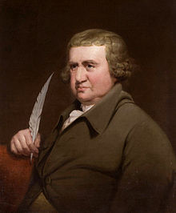
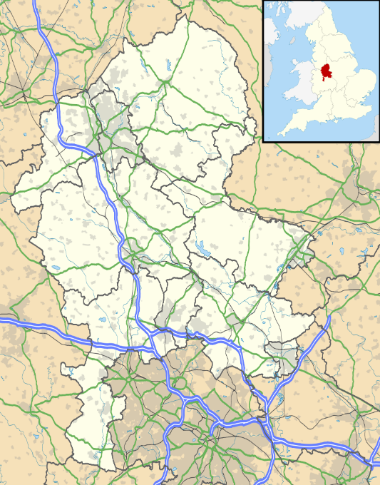
In the early 1800’s, a doctor riding about 10,000 miles a year to visit patients all over England got a better idea…
http://en.wikipedia.org/wiki/Erasmus_Darwin
http://en.wikipedia.org/wiki/Lichfield#mediaviewer/File:Staffordshire_UK_location_map.svg

Slide 27
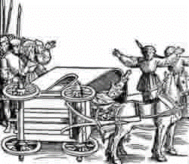
He found two essential problems or shortcomings of the commonly used Hungarian carriage. First, he recognized the danger of overturning. Apparently popes were not immune!
1415 coach overturn of Pope John XXIII
http://www.euachei.com.br/educacao/curiosidades/roda/

Slide 28
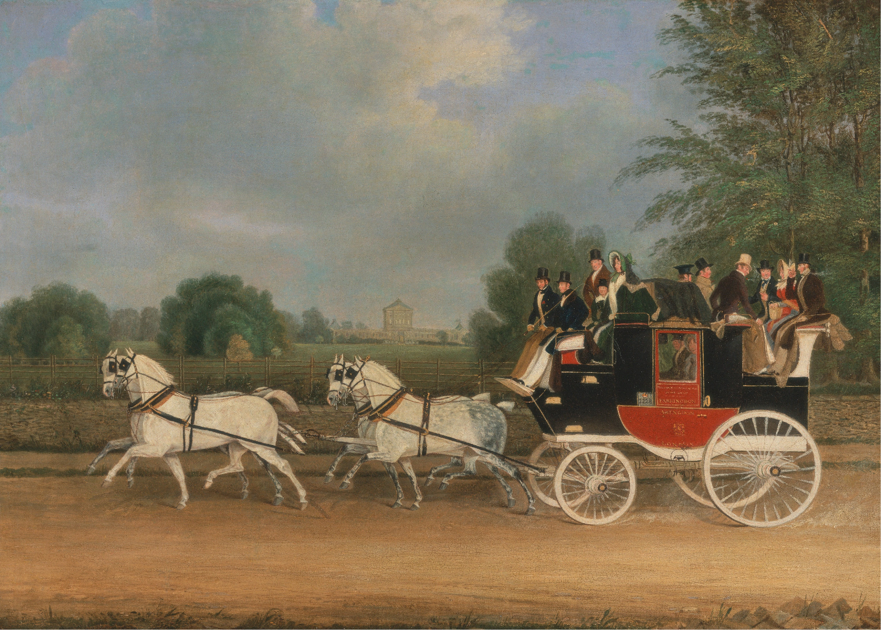
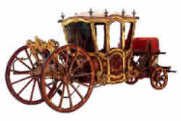
Second, the front wheels were quite small
The rider, carriage and horse felt the brunt of every bump on the road.
http://www.euachei.com.br/educacao/curiosidades/roda/
http://upload.wikimedia.org/wikipedia/commons/4/4d/James_Pollard_-_The_London-Faringdon_Coach_passing_Buckland_House,_Berkshire_-_Google_Art_Project.jpg

Slide 29
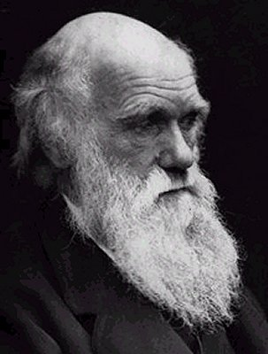
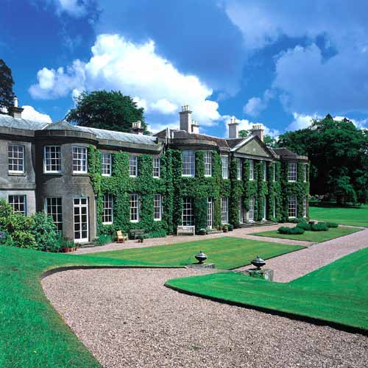
That doctor was Erasmus Darwin, grandfather of Charles Darwin
A particular technology was first introduced in 1758 by Erasmus Darwin, father of Charles Darwin, in a paper entitled "Erasmus Darwin's improved design for steering carriages--and cars". In 1816, George Langensperger introduced this same double-pivot mechanism in Munich, Germany. Rudolf Ackerman met Langensperger and acted as his patent agent in London, introducing it to British carriage builders. Unfortunately, Ackerman’s name has been on this device ever since! Charles Jeantaud added the concept mentioned above to eliminate wheel scrubbing when cornering, to keep carriage wheels from upsetting smooth gravel driveways.

Slide 30
Ackermann geometry is implemented in practice via a tie-rod
This type of steering geometry (δ_{i} > δ_{o}) is called Ackermann geometry. On typical cars, some level of Ackermann geometry is developed by a trapezoidal linkage.
steer
arm
tierod

Slide 31
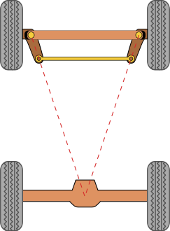
Simple approximation for Ackermann Geometry set-up
Steer Arms
When the wheels are perfectly straight (no steering angle), the steer arms will approximately align with the center of the rear axle
The tie rod is a rigid bar used to connect the steer arms to create a trapezoidal linkage
Tie Rod

Slide 32
The kinematics of a well-designed steering system have the tires all turning around the same center
Center of
turning radius
for left AND right wheel

Slide 33
It is easy to derive the relationship between zero-slip steering angle and the angle subtended by the vehicle.
Inside the triangle:
At steered wheel:
So:
∴the steer angle should be the angle subtended by the distance from the rear axle to the front wheel

Slide 34
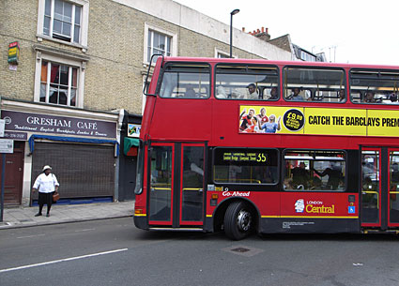
One consequence: buses have to turn a LOT more than passenger cars
Passenger cars are usually limited to 25 to 30 degrees of road wheel angle
Buses usually have 50 to 60 degrees of road wheel angle!

Slide 35
The relationship required for inside/outside steering is known as the Ackerman condition
For the inside tires:
And for outside:

Slide 36
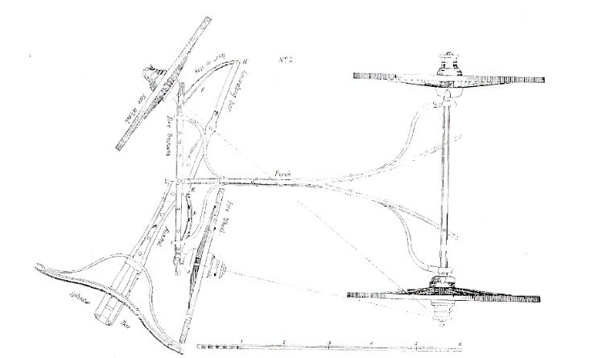
The Ackerman condition can be easily derived
Equating the two:

Slide 37
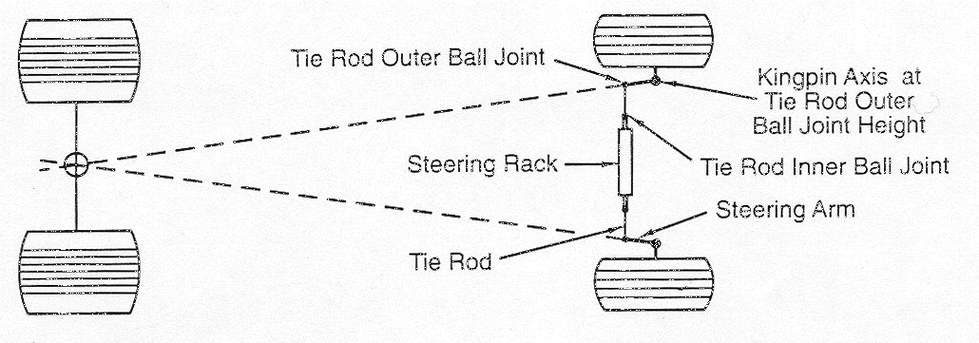
One approximation (inexact) to Ackermann geometry is to have the steer arm projections intersect at the center of the rear axle.

Slide 38
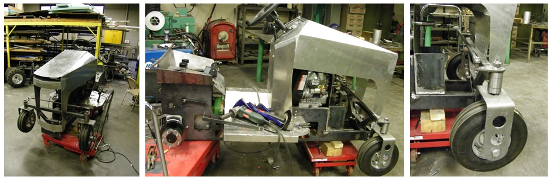
A Case Study on Steering Angle Difference of Two-Front Wheels of a ¼ Tractor

Slide 39
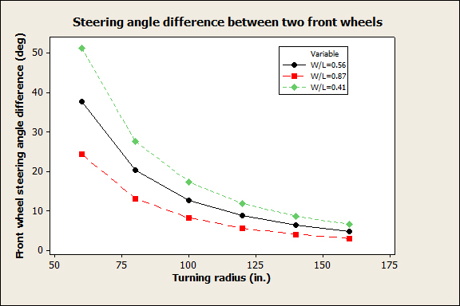
Basic dimensions were obtained through measurement as follows…
L (in.) | W(in.)
62 | 35
Need to decide between three W/L ratios, but on tractors, only allowed to steer the tires in parallel!

Slide 40
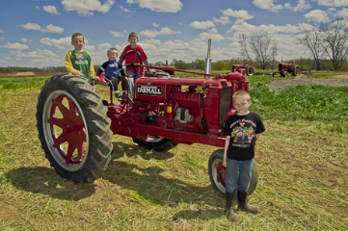
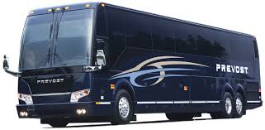
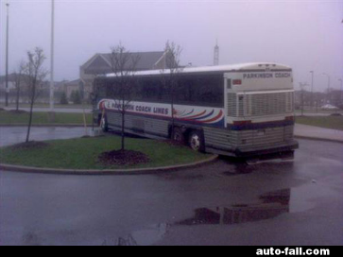
Result: longer tractors are better in terms of preventing skidding front tires
Also true in other long vehicles…
Problem is: long vehicles have large turn radii, so the tradeoff was originally made by placing tires close to each other. (Illegal now)
Today, Ackermann geometry is used

Slide 41
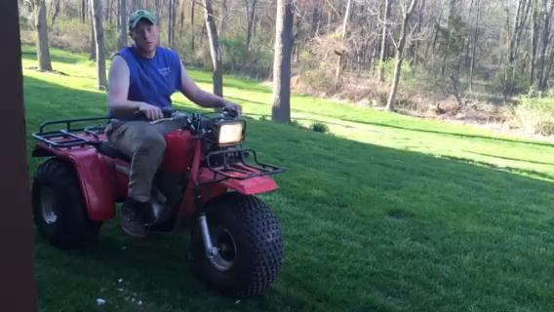
As noted before, the ability to pivot along an axis closer to the center makes 3-wheelers prone to rollover

Slide 42
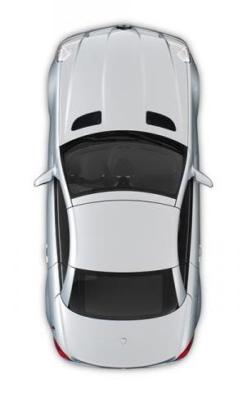
Thought question
How would Ackerman geometry change for a three-wheel vehicle, where the rear axle is a single wheel?
Notes:
Lesson 5, Slide 9

Slide 43
There are many different types of steering systems… you see variants everywhere!

Slide 44
Can we use kinematics to predict the steering angle required for a turn?
Simplest turning maneuver is rounding a long curve of constant radius at constant speed. This is called a steady state turn. All the states of the vehicle are in equilibrium.
Let’s first consider low speed turning. At low speed, the tire slip is minimal and vehicle cornering is based largely on kinematic constraints.

Slide 45
We have to impose some assumptions here…
Assume that the front wheels are the only ones being steered.
If the rear wheels generate no slip then the rear wheels must be perpendicular to the radius of curve at the wheels. i.e. the projection of the rear axle intersects the turn center
For the front wheels to not slip, they must also have perpendiculars that pass through the turn center.
Again, this is called kinematic steering

Slide 46
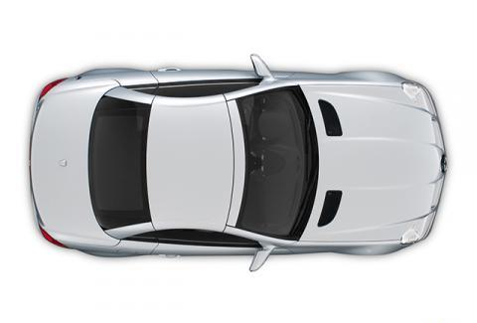
Here’s the geometry for low speed steady-state turning
Since the radii of curvature are usually much larger than the vehicle dimensions, small angle approximations apply.
δi
δo
R
a
Rrear (to center of wheel track)
b
L
T
Notes:
Lesson 5, Slide 13

Slide 47
We can now approximate the angle required for low-speed steering
Assuming small angle
As L increases (for example a long truck) one needs a sharper steer angle than if L is smaller (car)
steer
angle

Slide 48
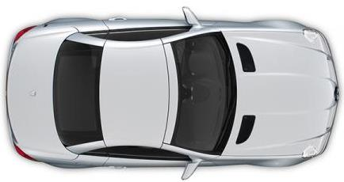
Variations on Ackermann Geometry
Ackermann
Reverse
Ackermann
Parallel
Notes:
Lesson 5, Slide 18

Slide 49
High-speed Ackermann Geometry
Small deviations from the Ackermann geometry have little effect on high speed directional response but greatly affect front tire wear. Deviations do affect the self-centering torque at low speeds.
With Ackermann and const speed, the resisting torque will grow with steer angle. If the steer angle is the same for δ_{i} = δ_{o}, the resisting torque will first grow with steer angle but may diminish at high steer angles.

Slide 50
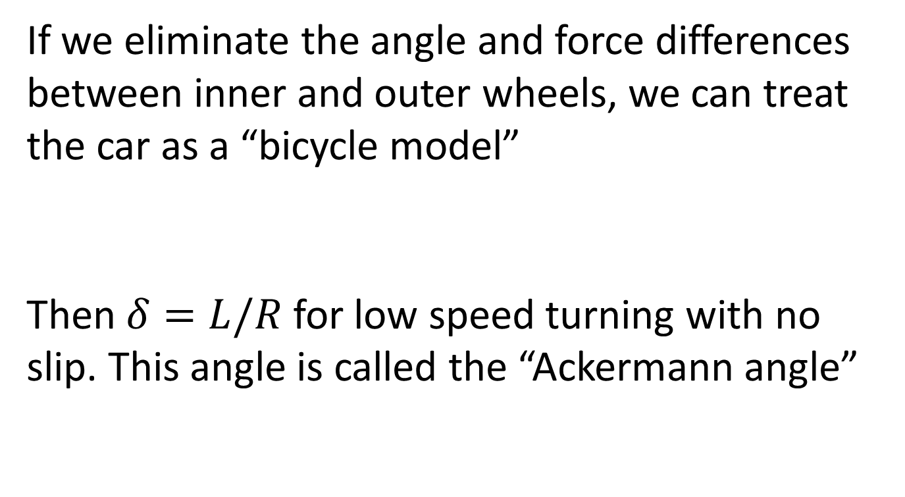
What is the difference between Ackerman angle and Ackerman geometry?
If we eliminate the angle and force differences between inner and outer wheels, we can treat the car as a “bicycle model”
Then $δ=L/R$ for low speed turning with no slip. This angle is called the “Ackermann angle”
δ
Not to be confused with Ackerman steering geometry.

Slide 51
Automotive Vehicle Dynamics
Sean Brennan
Department of Mechanical and Nuclear Engineering
Penn State University
sbrennan@psu.edu

Slide 52
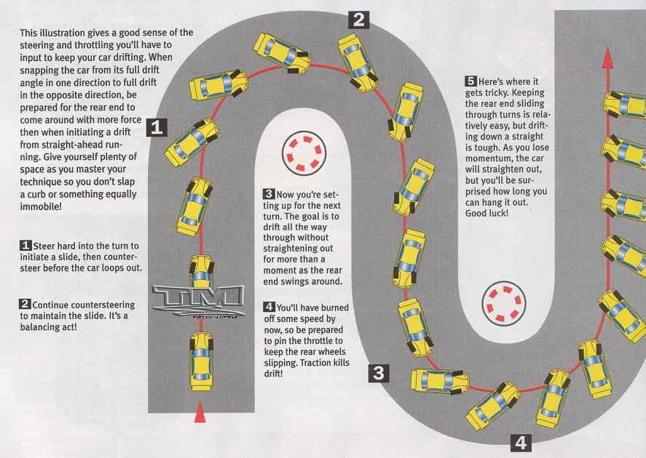
Drifting?

Slide 53
Ackerman Steering Study

Slide 54
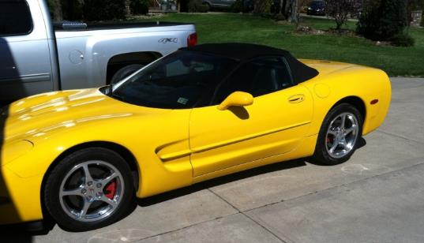
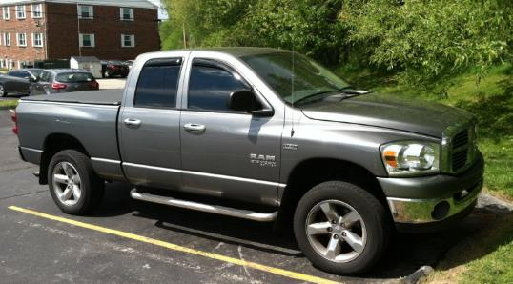
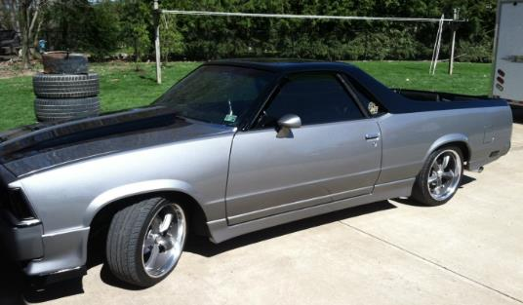
Vehicles Tested
2001 Chevrolet Corvette
2008 Dodge Ram 1500 4x4
1978 Chevrolet El Camino
Vehicle Measurements
 | W (m) | L (m)
Corvette | 1.575 | 2.654
Ram | 1.524 | 3.569
El Camino | 1.479 | 2.972

Slide 55
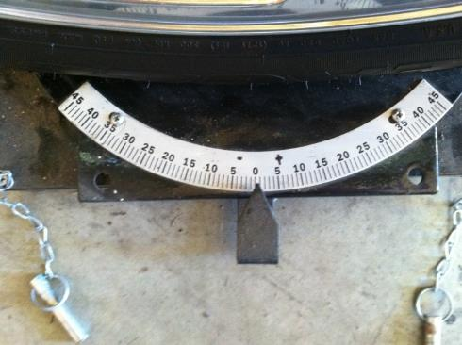
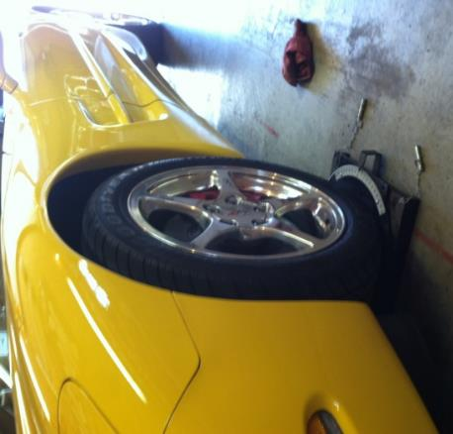
Test Procedure
Turn plates where used to measure steering angle (δ) at the tire
Steering wheel was turned until the outside tire (independent variable) was at a predetermined angle and then the inner tire steering angle was measured (dependent variable)
Both positive and negative steering inputs were measured, however the results were opposites of each other so only positive steering inputs are used in the analysis

Slide 56
Data and Analysis
δ_{inside} Measured (Degrees) | δ_{outside} Measured (Degrees) | δaverage Measured (Degrees) | R_{inside} | R_{outside} | R_{avg} | Steer Angle L/R_{avg} | δ_{inside} Calculated | δ_{outside} Calculated | δ_{inside} %error | δ_{outside} %error | Average δ %error
2001 Chevrolet Corvette
6.0 | 5.0 | 5.5 | 26.0 | 29.6 | 27.8 | 5.5 | 5.6 | 5.3 | 6.9 | 5.8 | 6.3
11.5 | 10.0 | 10.8 | 13.8 | 14.3 | 14.0 | 10.8 | 11.3 | 10.1 | 1.6 | 1.4 | 1.5
17.0 | 15.0 | 16.0 | 9.5 | 9.1 | 9.3 | 16.4 | 17.3 | 14.8 | 1.9 | 1.7 | 1.8
22.5 | 20.0 | 21.3 | 7.2 | 6.5 | 6.9 | 22.2 | 23.6 | 19.2 | 4.8 | 4.4 | 4.6
28.0 | 25.0 | 26.5 | 5.8 | 4.9 | 5.3 | 28.5 | 30.2 | 23.4 | 7.4 | 6.8 | 7.1
2008 Dodge Ram 1500 4x4
6.0 | 5.0 | 5.5 | 34.7 | 40.0 | 37.4 | 5.5 | 5.6 | 5.3 | 7.8 | 6.5 | 7.1
12.0 | 10.0 | 11.0 | 17.6 | 19.5 | 18.5 | 11.0 | 11.4 | 10.5 | 5.6 | 4.7 | 5.1
17.5 | 15.0 | 16.3 | 12.1 | 12.6 | 12.3 | 16.6 | 17.2 | 15.3 | 2.0 | 1.7 | 1.8
22.5 | 20.0 | 21.3 | 9.4 | 9.0 | 9.2 | 22.2 | 22.9 | 19.7 | 1.7 | 1.6 | 1.7
28.0 | 25.0 | 26.5 | 7.5 | 6.9 | 7.2 | 28.5 | 29.1 | 24.2 | 3.7 | 3.3 | 3.5
1978 Chevrolet El Camino
6.5 | 5.0 | 5.8 | 26.8 | 33.2 | 30.0 | 5.7 | 5.8 | 5.5 | 12.2 | 9.4 | 10.8
12.0 | 10.0 | 11.0 | 14.7 | 16.1 | 15.4 | 11.0 | 11.4 | 10.4 | 4.8 | 4.0 | 4.4
17.5 | 15.0 | 16.3 | 10.2 | 10.4 | 10.3 | 16.6 | 17.3 | 15.1 | 0.9 | 0.8 | 0.9
23.0 | 20.0 | 21.5 | 7.7 | 7.4 | 7.6 | 22.5 | 23.5 | 19.6 | 2.0 | 1.8 | 1.9
28.5 | 25.0 | 26.8 | 6.2 | 5.6 | 5.9 | 28.7 | 29.8 | 24.0 | 4.4 | 4.0 | 4.2

Slide 57
Results - Corvette

Slide 58
Results - Ram

Slide 59
Results – El Camino

Slide 60
Observations
δ_{inside} Measured (Degrees) | δ_{outside} Measured (Degrees) | δaverage Measured (Degrees) | R_{inside} | R_{outside} | R_{avg} | Steer Angle L/R_{avg} | δ_{inside} Calculated | δ_{outside} Calculated | δ_{inside} %error | δ_{outside} %error | Average δ %error
2001 Chevrolet Corvette
6.0 | 5.0 | 5.5 | 26.0 | 29.6 | 27.8 | 5.5 | 5.6 | 5.3 | 6.9 | 5.8 | 6.3
11.5 | 10.0 | 10.8 | 13.8 | 14.3 | 14.0 | 10.8 | 11.3 | 10.1 | 1.6 | 1.4 | 1.5
17.0 | 15.0 | 16.0 | 9.5 | 9.1 | 9.3 | 16.4 | 17.3 | 14.8 | 1.9 | 1.7 | 1.8
22.5 | 20.0 | 21.3 | 7.2 | 6.5 | 6.9 | 22.2 | 23.6 | 19.2 | 4.8 | 4.4 | 4.6
28.0 | 25.0 | 26.5 | 5.8 | 4.9 | 5.3 | 28.5 | 30.2 | 23.4 | 7.4 | 6.8 | 7.1
2008 Dodge Ram 1500 4x4
6.0 | 5.0 | 5.5 | 34.7 | 40.0 | 37.4 | 5.5 | 5.6 | 5.3 | 7.8 | 6.5 | 7.1
12.0 | 10.0 | 11.0 | 17.6 | 19.5 | 18.5 | 11.0 | 11.4 | 10.5 | 5.6 | 4.7 | 5.1
17.5 | 15.0 | 16.3 | 12.1 | 12.6 | 12.3 | 16.6 | 17.2 | 15.3 | 2.0 | 1.7 | 1.8
22.5 | 20.0 | 21.3 | 9.4 | 9.0 | 9.2 | 22.2 | 22.9 | 19.7 | 1.7 | 1.6 | 1.7
28.0 | 25.0 | 26.5 | 7.5 | 6.9 | 7.2 | 28.5 | 29.1 | 24.2 | 3.7 | 3.3 | 3.5
1978 Chevrolet El Camino
6.5 | 5.0 | 5.8 | 26.8 | 33.2 | 30.0 | 5.7 | 5.8 | 5.5 | 12.2 | 9.4 | 10.8
12.0 | 10.0 | 11.0 | 14.7 | 16.1 | 15.4 | 11.0 | 11.4 | 10.4 | 4.8 | 4.0 | 4.4
17.5 | 15.0 | 16.3 | 10.2 | 10.4 | 10.3 | 16.6 | 17.3 | 15.1 | 0.9 | 0.8 | 0.9
23.0 | 20.0 | 21.5 | 7.7 | 7.4 | 7.6 | 22.5 | 23.5 | 19.6 | 2.0 | 1.8 | 1.9
28.5 | 25.0 | 26.8 | 6.2 | 5.6 | 5.9 | 28.7 | 29.8 | 24.0 | 4.4 | 4.0 | 4.2
All of the vehicles seem to have a “sweet spot” where the calculated δ most closely matched the measured δ (shown from lowest percent error). In all three cases the “sweet spot” is for about a 10-11m radius turn. This shows that a vehicles steering system is not designed for perfect ackerman condition for all radius turns, rather it optimized for certain turn radius or approximately 10-11m.

Slide 61
Observations
δ_{inside} Measured (Degrees) | δ_{outside} Measured (Degrees) | δaverage Measured (Degrees) | R_{inside} | R_{outside} | R_{avg} | Steer Angle L/R_{avg} | δ_{inside} Calculated | δ_{outside} Calculated | δ_{inside} %error | δ_{outside} %error | Average δ %error
2001 Chevrolet Corvette
6.0 | 5.0 | 5.5 | 26.0 | 29.6 | 27.8 | 5.5 | 5.6 | 5.3 | 6.9 | 5.8 | 6.3
11.5 | 10.0 | 10.8 | 13.8 | 14.3 | 14.0 | 10.8 | 11.3 | 10.1 | 1.6 | 1.4 | 1.5
17.0 | 15.0 | 16.0 | 9.5 | 9.1 | 9.3 | 16.4 | 17.3 | 14.8 | 1.9 | 1.7 | 1.8
22.5 | 20.0 | 21.3 | 7.2 | 6.5 | 6.9 | 22.2 | 23.6 | 19.2 | 4.8 | 4.4 | 4.6
28.0 | 25.0 | 26.5 | 5.8 | 4.9 | 5.3 | 28.5 | 30.2 | 23.4 | 7.4 | 6.8 | 7.1
2008 Dodge Ram 1500 4x4
6.0 | 5.0 | 5.5 | 34.7 | 40.0 | 37.4 | 5.5 | 5.6 | 5.3 | 7.8 | 6.5 | 7.1
12.0 | 10.0 | 11.0 | 17.6 | 19.5 | 18.5 | 11.0 | 11.4 | 10.5 | 5.6 | 4.7 | 5.1
17.5 | 15.0 | 16.3 | 12.1 | 12.6 | 12.3 | 16.6 | 17.2 | 15.3 | 2.0 | 1.7 | 1.8
22.5 | 20.0 | 21.3 | 9.4 | 9.0 | 9.2 | 22.2 | 22.9 | 19.7 | 1.7 | 1.6 | 1.7
28.0 | 25.0 | 26.5 | 7.5 | 6.9 | 7.2 | 28.5 | 29.1 | 24.2 | 3.7 | 3.3 | 3.5
1978 Chevrolet El Camino
6.5 | 5.0 | 5.8 | 26.8 | 33.2 | 30.0 | 5.7 | 5.8 | 5.5 | 12.2 | 9.4 | 10.8
12.0 | 10.0 | 11.0 | 14.7 | 16.1 | 15.4 | 11.0 | 11.4 | 10.4 | 4.8 | 4.0 | 4.4
17.5 | 15.0 | 16.3 | 10.2 | 10.4 | 10.3 | 16.6 | 17.3 | 15.1 | 0.9 | 0.8 | 0.9
23.0 | 20.0 | 21.5 | 7.7 | 7.4 | 7.6 | 22.5 | 23.5 | 19.6 | 2.0 | 1.8 | 1.9
28.5 | 25.0 | 26.8 | 6.2 | 5.6 | 5.9 | 28.7 | 29.8 | 24.0 | 4.4 | 4.0 | 4.2
The δ=L/R assumption for steady state turning around a large turn radius was also proved. At larger turn radiuses this assumption is perfect and above about a 10m radius turn the assumption remains very accurate.

Slide 62
Further Analysis
The last metric I looked at was using the ackerman condition equation. I calculated the ideal w/l and compared it to cot(θ_{o}) –cot(θ_{i}) for the θ=δ steering angles at all the measured turn radiuses.
As seen on the next slide, cot(θ_{o}) –cot(θ_{i}) =w/l at a turn radius around 9-11m for all 3 vehicles. This again shows the design “sweet spot”
It is surprising a large truck has such a similar steering geometry as a sports car

Slide 63
Further Analysis

